Slide 1
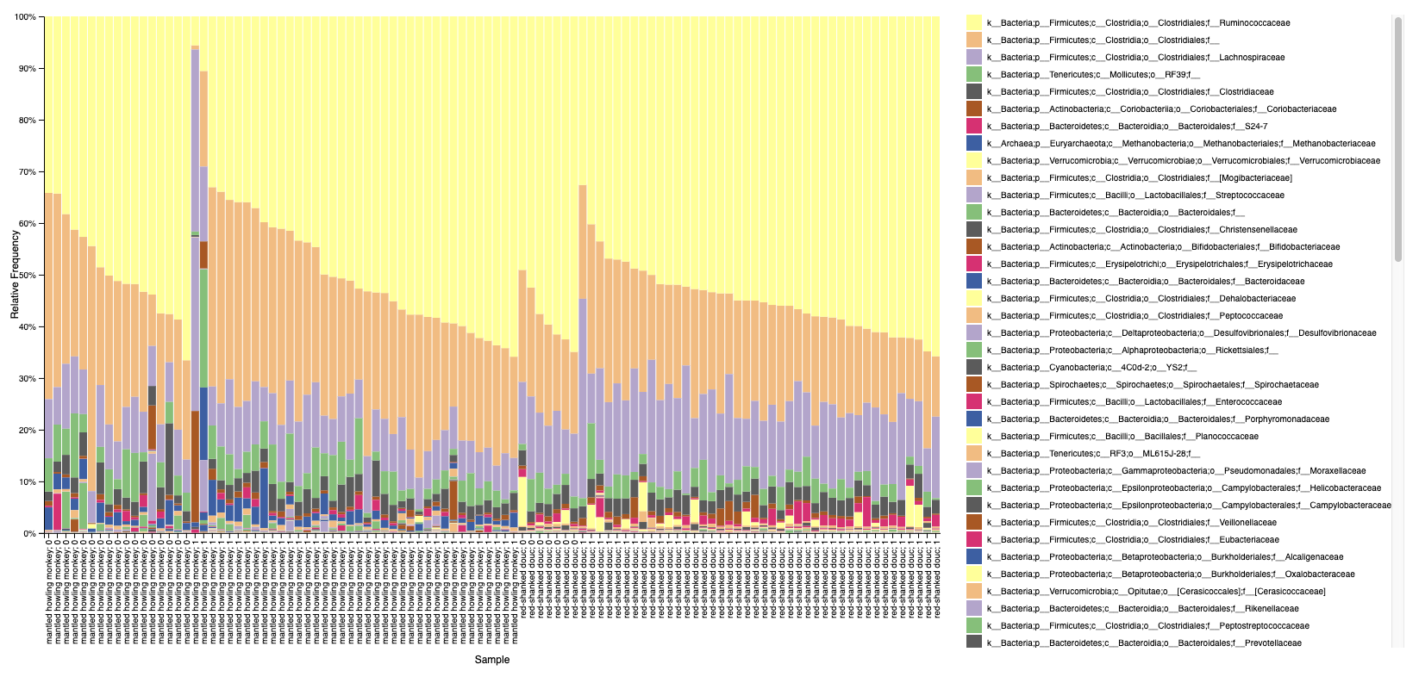
Monkey species : presence(1)/absence(0) parasites by microscopy

Slide 2
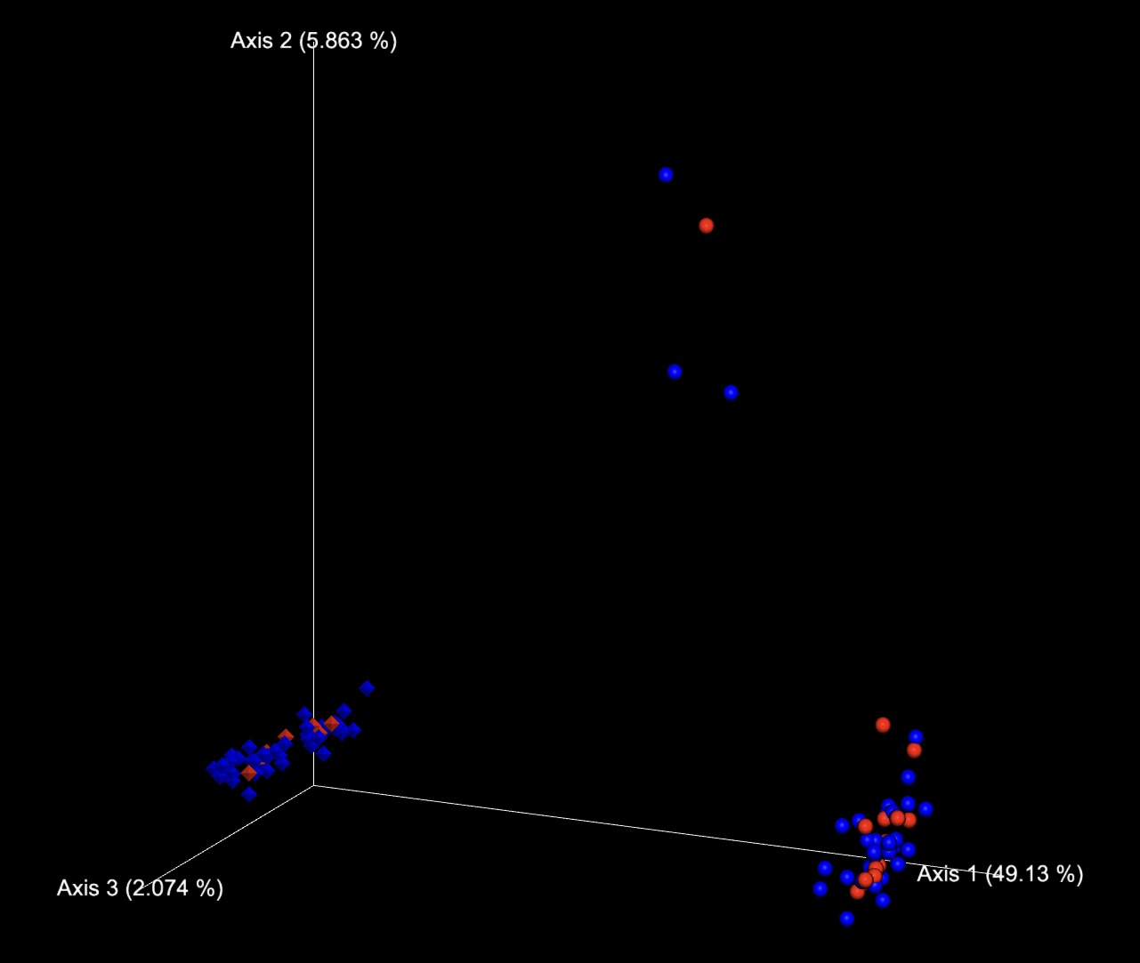
Captive howlers
Unweighted Unifrac
Blue = parasite positive
Red = no parasite
Diamond = douc
Sphere = howler
Wild howlers, except the very top one (recent captive)

Slide 3
Faith’s PD
Shannon

Slide 4
howlers
Faith’s PD vs parasite presence
Shannon vs parasite presence

Slide 5
doucs
Faith’s PD vs parasite presence
Shannon vs parasite presence

